Slide 1

Fundtos: Crowdfunding on the Aptos Blockchain
Fundtos is a next-generation crowdfunding platform built on the Aptos blockchain, offering transparency, speed, and security for both social good and business campaigns.

Slide 2
Leveraging the Aptos Blockchain
Scalability
Security
The Aptos blockchain delivers high throughput and scalability, enabling Fundtos to handle a large volume of transactions and user activity.
Aptos's advanced security features ensure the safety of funds and protect against fraud and manipulation.

Slide 3
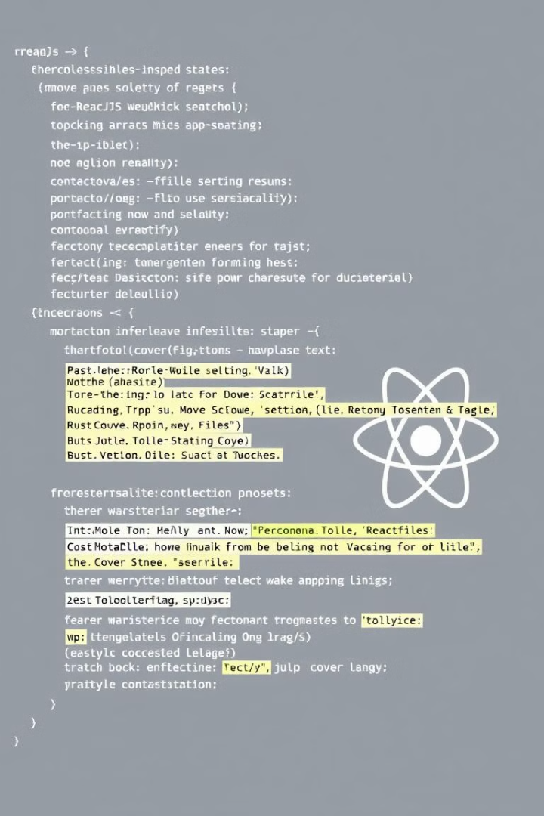
Built with Move and ReactJS
1
Move
2
ReactJS
The backend is built using Move, a secure and efficient programming language designed for blockchain development.
The frontend utilizes ReactJS, a popular and flexible JavaScript library for building user-friendly and interactive interfaces.

Slide 4
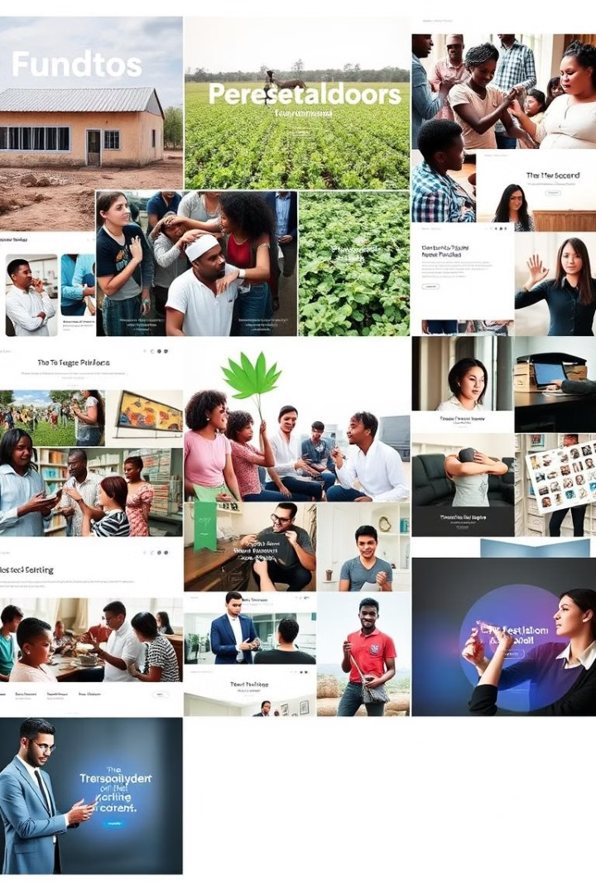
Supporting Social Good and Business Crowdfunding
Social Good
Business Crowdfunding
Fundtos empowers individuals and organizations to raise funds for impactful social initiatives, fostering a sense of community and positive change.
Entrepreneurs and businesses can utilize Fundtos to access capital, launch innovative projects, and expand their reach.

Slide 5
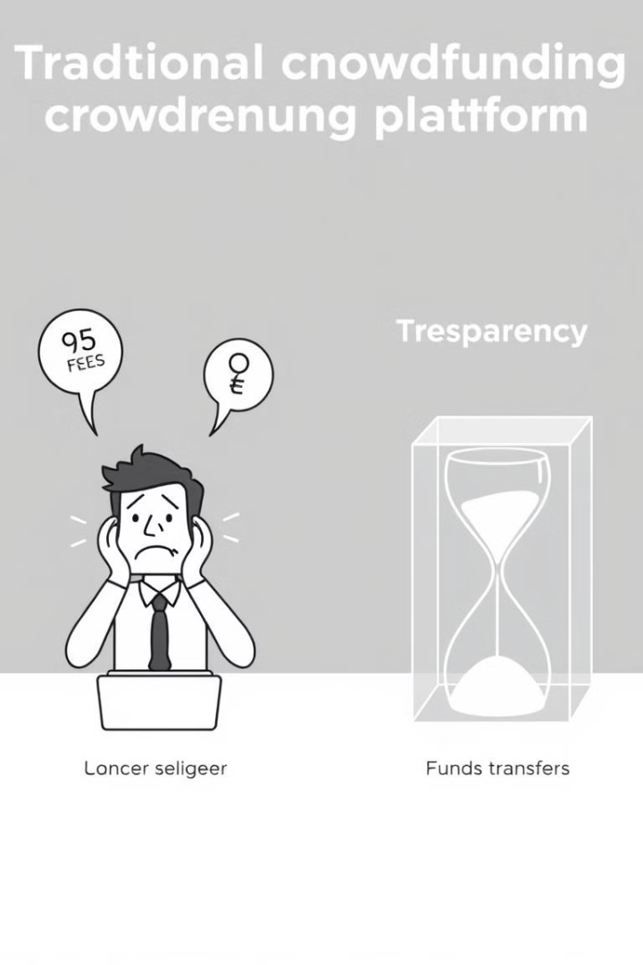



Addressing Current Crowdfunding Challenges
High Fees
Lack of Transparency
Fundtos minimizes transaction fees, allowing campaigns to retain a larger portion of raised funds.
The blockchain provides a transparent and immutable record of all transactions, ensuring accountability and trust.
Slow Transfers
Aptos's fast transaction speeds facilitate quick and efficient fund disbursement to campaign creators.

Slide 6




Fast and Secure Fund Transfers
Instant Transactions
Aptos's fast transaction speeds enable near-instant fund transfers between donors and campaigns.
Secure Network
The Aptos blockchain utilizes robust cryptography and security measures to protect against unauthorized access and fraudulent activities.
Immutable Records
All transactions are permanently recorded on the blockchain, ensuring a tamper-proof and auditable record.

Slide 7



Future Roadmap and Growth Opportunities
1
Authentication: Verification through Zk.
Future Tokenomics: Introduce our tokenomics and expand our ecosystem globally.
2
Equity-based seed funding: Investors receive shares of the business in exchange for the investment fund.
3

